Slide 1

TradeRecon AI
AI-Powered Trade Reconciliation System
Intelligent automation for faster, safer, and audit-ready financial operations

Slide 2
The Challenge of Trade Reconciliation
Manual Process Limitations
System Deficiencies
Financial institutions process thousands of trades daily across multiple brokers and exchanges. Traditional manual reconciliation creates significant operational bottlenecks and compliance risks.
Even automated systems struggle with the complexity of modern trading environments, leaving critical gaps in operational integrity.
Complex mismatch scenarios
Time-intensive matching processes
Missing trade detection failures
Human error in data interpretation
Limited root-cause analysis
Inconsistent documentation standards
Poor regulatory reporting
Delayed exception resolution

Slide 3


Introducing TradeRecon AI
A fully automated trade reconciliation platform powered by advanced AI technology that transforms how financial institutions manage trade matching, exception handling, and compliance reporting.
Precise Matching
Exception Detection
Automated broker vs. exchange trade comparison with intelligent field validation
Identifies mismatches, missing trades, and anomalies in real-time
AI Intelligence
Compliance Ready
Single-call LLM analysis provides root-cause insights and recommendations
Generates audit-friendly reports with full traceability and documentation

Slide 4
AI Intelligence Engine
One Unified Analysis Framework
Unlike traditional systems requiring multiple tools and manual interpretation, TradeRecon AI uses a single structured AI engine to deliver comprehensive insights for every exception detected during reconciliation.
01
02
Root Cause Identification
Severity Classification
Determines the underlying reason for discrepancies with context-aware analysis
Assigns risk levels to prioritize operational response and resource allocation
03
04
Fix Recommendations
Risk Assessment
Provides actionable remediation steps based on exception type and impact
Evaluates potential exposure including financial, operational, and regulatory risks
05
06
Compliance Summary
Narrative Explanation
Generates regulatory-aligned documentation with full audit trail
Creates human-readable interpretations for stakeholder communication

Slide 5

Core System Capabilities
Reconciliation Engine
Compliance Report Generator
Streamlit User Interface
Performs comprehensive validation of trade records across multiple dimensions. Checks critical fields including trade ID, quantity, price, and timestamps. Intelligently handles numeric drift and time zone differences while maintaining strict accuracy standards.
Produces audit-friendly documentation that meets regulatory requirements. Reports include full exception detail, AI-driven analysis, remediation tracking, and executive summaries. Exportable in multiple formats for seamless integration with existing workflows.
Clean, intuitive dashboard for operations teams. Upload CSV files from any source, view real-time reconciliation metrics, explore exception details with drill-down capabilities, trigger AI analysis on-demand, and download complete results in Markdown and JSON formats.

Slide 6




System Architecture
Modular Design for Enterprise Scalability
matching.py
intelligence_engine.py
Trade comparison engine and exception generation module
Single AI reasoning engine for all exception analysis
main.py
app.py
Orchestration layer coordinating reconciliation and AI workflows
Streamlit interface providing user interaction and visualization
Technology Stack
AI & Configuration
Python — Core development language
Groq API — High-performance LLM inference
Streamlit — Interactive UI framework
dotenv — Secure configuration management
Pandas — Data processing and analysis

Slide 7
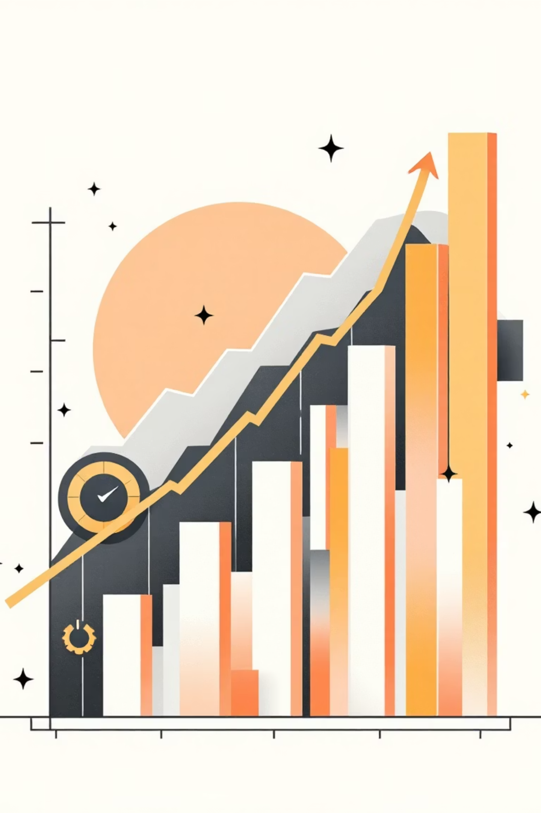
Measurable Business Impact
80%
100%
60%
Effort Reduction
Error Elimination
Faster Resolution
Eliminates manual reconciliation tasks and investigation time
Removes human interpretation errors from exception analysis
Accelerates investigation and remediation cycles
Strategic Advantages
Standardized compliance documentation across all trades and exceptions
Improved regulatory readiness with automated reporting
Scalable architecture supporting growing trade volumes
Enhanced operational transparency with full audit trails

Slide 8
Simple Demo Workflow
From Data Upload to Audit-Ready Report in Minutes
Upload Files
1
Import broker and exchange CSV files through intuitive interface
2
Review Metrics
View matched trades, mismatches, and missing records instantly
Run Analysis
3
Execute Intelligent Reconciliation with one-click AI processing
4
Explore Insights
Examine AI-driven root causes, severity levels, and recommendations
Download Report
5
Export complete audit-ready documentation in multiple formats

Slide 9

Project Team
Suresh Babu G
Project Owner & Developer
Technical architect and lead developer driving the vision and implementation of TradeRecon AI's intelligent reconciliation capabilities.
Ashutosh L. Pandey
Co-Developer
Core development contributor focusing on system architecture, AI integration, and user experience optimization.

Slide 10

The Future of Trade Reconciliation
TradeRecon AI brings intelligent automation to trade reconciliation—transforming financial operations to be faster, safer, and audit-ready. By combining precise matching with advanced AI reasoning, we're setting a new standard for operational excellence in financial services.
Ready to revolutionize your trade reconciliation process? Experience the power of AI-driven financial operations today.

